Slide 1
Malnutrition and Sarcopenia: Definition, Prevention and Management
Mary O’Kane MSc, FBDA
Honorary Consultant Dietitian Leeds Teaching Hospitals NHS Trust

Slide 2
I have no conflicts of interest

Slide 3
Definitions
Malnutrition
(World Health Organisation)
Sarcopenia
(European Consensus Cruz-Jentoft et al 2019)
“deficiencies, excesses or imbalances in a person’s intake of energy and/or nutrients”
‘undernutrition’ includes micronutrient deficiencies or insufficiencies
‘overweight, obesity and diet-related noncommunicable diseases’(such as heart disease, stroke, diabetes, and cancer).
Sarcopenic obesity
Co-existence of obesity and sarcopenia ESPEN & EASO Donini et al 2022

Slide 4
Risk factors for Malnutrition, Sarcopenia and Sarcopenic Obesity
Acute disease and Long-term Health Conditions
Inadequate intake of energy or protein, which may be due to anorexia, malabsorption, limited access to healthy foods or limited ability to eat
Sedentary lifestyle/ low physical activity lifestyle or disease related immobility or disability
Social Isolation and Poverty
Aging
Weight loss treatments and weight cycling
Impact on Quality of Life : Higher comorbidity risks; Poorer outcomes for several clinical conditions;
Impact on independence, impaired mobility, Frailty, fractures, cognitive decline, loss of autonomy

Slide 5
Prevention –early detection and intervention
Consider
Amount and rate of weight loss
Nutritional intake –quality and quantity
Physical function –ability to climb stairs, walk, chair to stand, hand grip strength, walking – improvement or deterioration
Ability to perform daily activities – cook, carry shopping
Social circumstances and support
Donini er al Obes Facts 2022;15;321-335

Slide 6
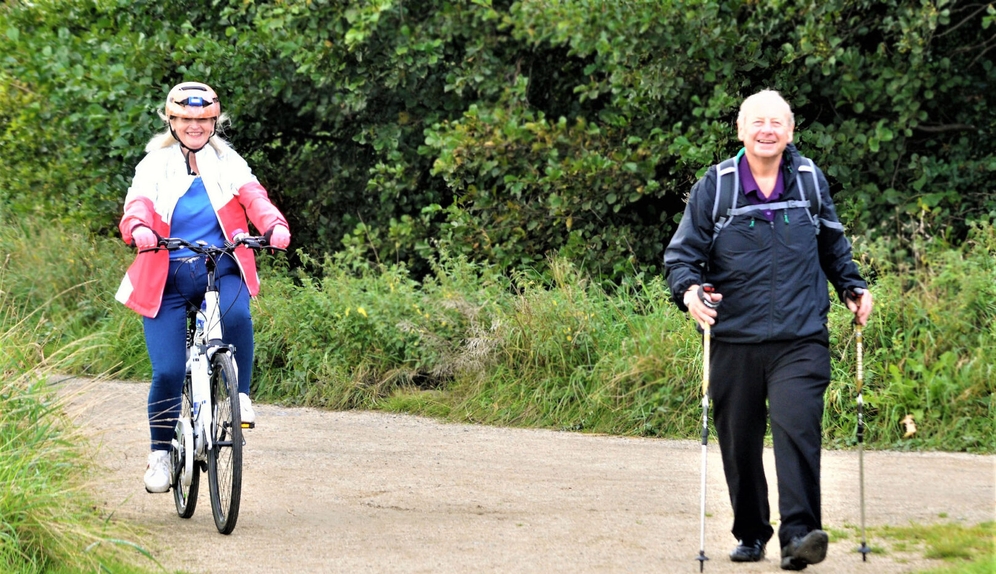
Prevention post Metabolic Bariatric Surgery
Nutrition
Balanced diet including good protein intake
Nutritional assessment and monitoring
Vitamin and mineral supplements
Energy intake important too!
Physical activity
Reduce sedentary behaviour
Resistance training combined with aerobic training
ECPO image bank

Slide 7
Protein and prevention post MBS Recommendations vs reality
A minimal protein intake of 60 g/day and up to 1.5 g/kg ideal body weight (IBW) per day should be adequate; higher amounts of protein intake (up to 2.1 g/kg IBW per day) need to be assessed on an individualised basis Mechanick et al 2020
Nutrients 2021, 13, 771.
 | 1 month | 3 months
Dietary protein g/day | 30.0 | 34.9
Adherence to modular protein supplement | 63.8% | 21.3%
“only four patients (8.5%) met the minimal recommended protein intake at both 1 and 3 months.”

Slide 8
Metabolic bariatric surgery (MBS)
Sarwer et al. 2008
Energy density and relative macronutrient content (including
protein content remained the same
“no overall changes in relative intake of high-fat, low-fat, sweet, and savoury foods; macronutrient intake; or energy density of the meal”

Slide 9
Prevention
Individualised, timely and holistic dietetic support
Consider cooking skills, income, access to affordable foods
Practical targeted advice
Textures, satiety
Food fortification
High-quality protein intake and even distribution of daily protein intake across meals
Adequate energy intake as part of a balanced diet

Slide 10
Effect of exercise training after metabolic bariatric surgery Bellicha et al 2021
Resistance training programs MBS surgery
Rapid gains in muscle strength after a 3-months
Reduce lean mass loss with longer interventions (e.g., >9 months)
ECPO Image Bank
Aerobic training - feasible from 3 months after MBS, may be beneficial for further improving cardiorespiratory fitness
Aerobic and resistance training
Lower decrease in bone mineral density
Most promising to improve both cardiorespiratory and muscular fitness
At least 150-300 mins of moderate-vigorous intensity aerobic physical activity per week and
muscle-strengthening exercises on two or more days per week
Addressing sarcopenic obesity in the WHO European Region: challenges and solutions

Slide 11
Physical activity post MBS Recommendations vs reality
Some positive improvements with small decreases in sedentary behaviour and small increases in physical activity;
however,
Most patients continue to have low levels of activity and be highly sedentary through the first 3 years following surgery

Slide 12
Physical activity– address the barriers
Identify and discuss barriers: lack of time, motivation, work, other commitments, stigma, body image, cost, clothing
Provide tailored advice to at-risk individuals, emphasizing resistance-based exercise to improve lean body mass, strength and function
Facilitate referrals to community-based physical activity programmes and offer reimbursement for exercise interventions where applicable
Focus on optimizing fat mass loss while preserving muscle mass and function
Consider online programmes
Addressing sarcopenic obesity in the WHO European Region: challenges and solutions

Slide 13
Management of malnutrition and sarcopenia
Comprehensive multiprofessional assessment
Comprehensive dietetic and nutritional assessment and support
Individualised dietetic advice
Address micronutrient deficiencies
Weight maintenance or weight loss – appropriate energy intake
Balanced diet - protein intake of 1.2–1.5 g/kg/IBW per day or those with severe malnutrition may need 2 g/kg/IBW per day
Access to community-based cookery classes
Physical activity
Reduce sedentary behaviour
Increase physical activity – resistance and aerobic activity
Access to group exercise classes

Slide 14
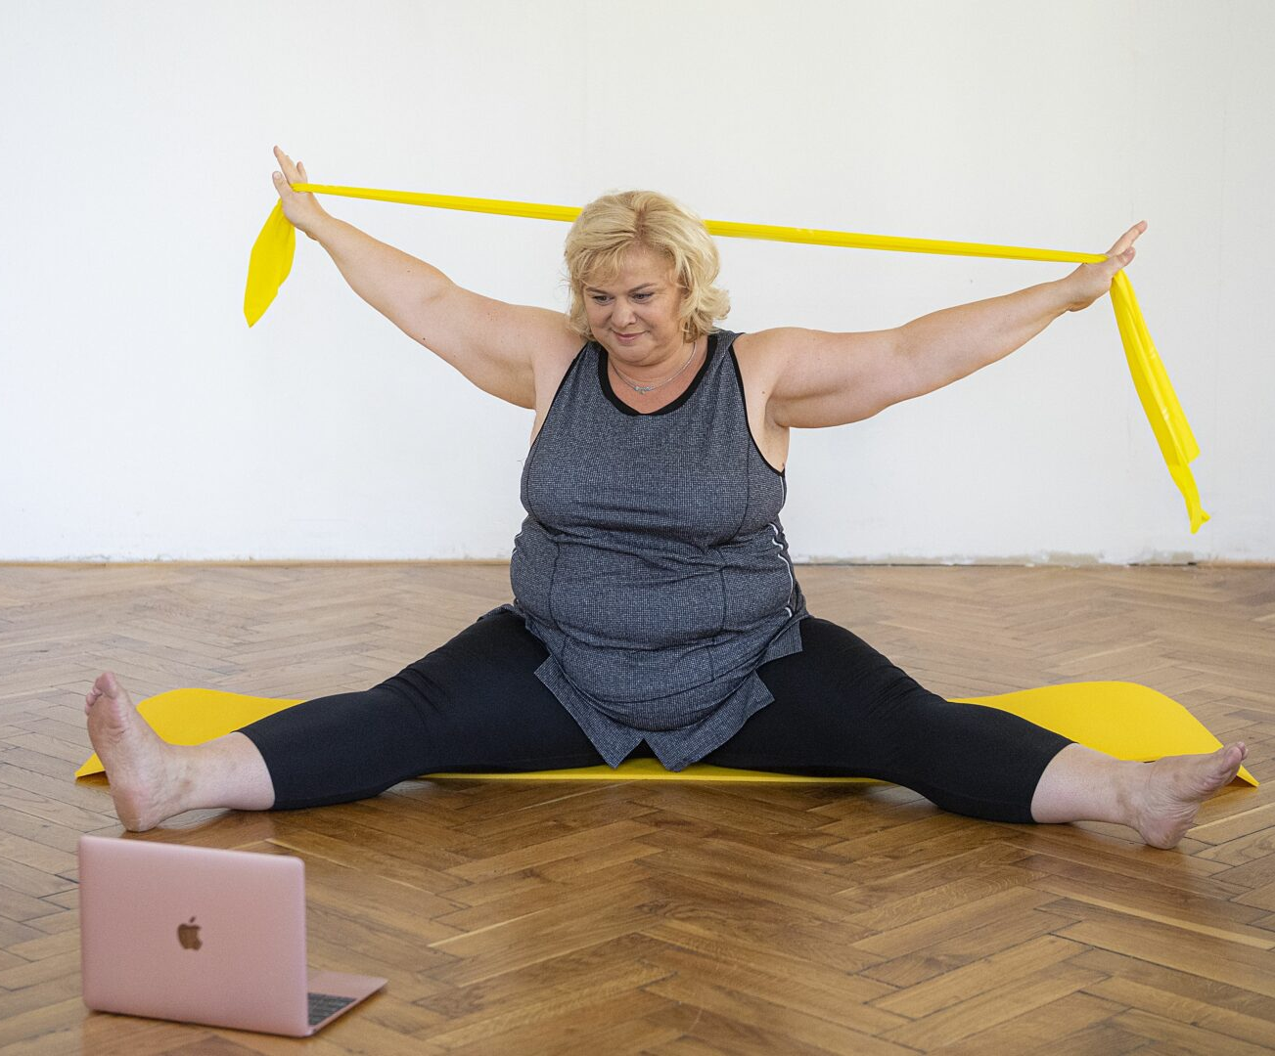
ECPO Image Bank

Slide 15
Grazie

